Slide 1


TIME TO HARVEST FROM INVESTMENT SEED
Notes:
ตกแต่งตามโทนสีได้เลยครับ

Slide 2
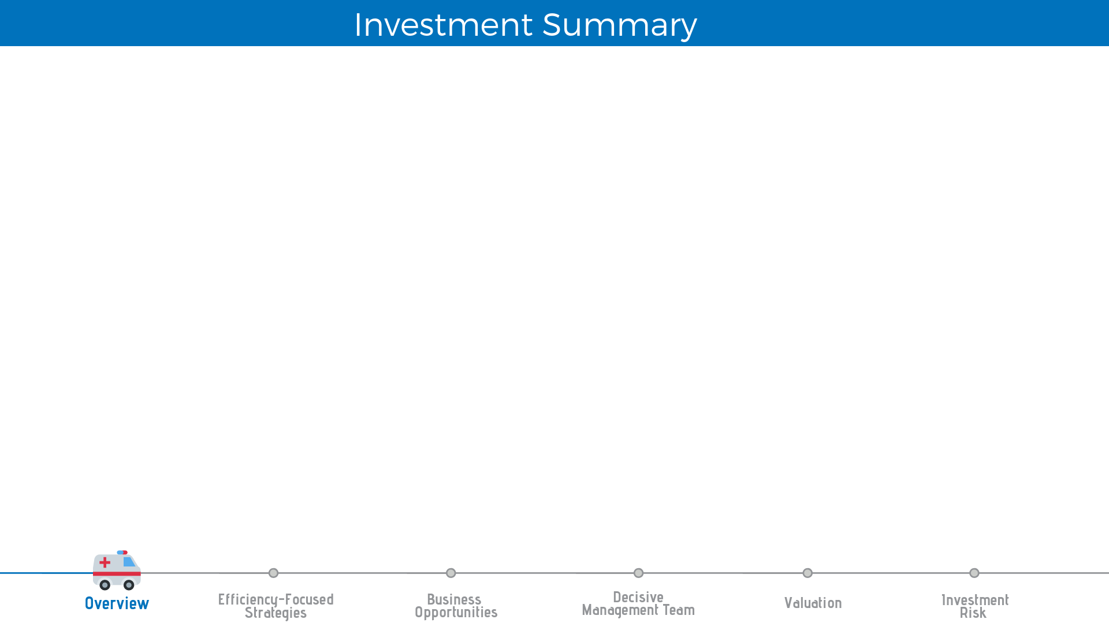
Target Price
THB 27.00
Market Price
THB 23.60 at 17th Jan 2019
Recommendation
BUY
15% of upside
75% DCF + 25% P/E multiplier
Efficiency-focused Strategies
from the Solid Business Model
Business Opportunities
For both Oversea and Domestic Demand
Decisive
Management Team
Sustaining Financial Performance
and
Implementing Effective Strategies
Notes:
ขอแบบมาทีละช่องนะครับ
BUY
THB 27.00
15%
70% DCF + 30% P/E

Slide 3
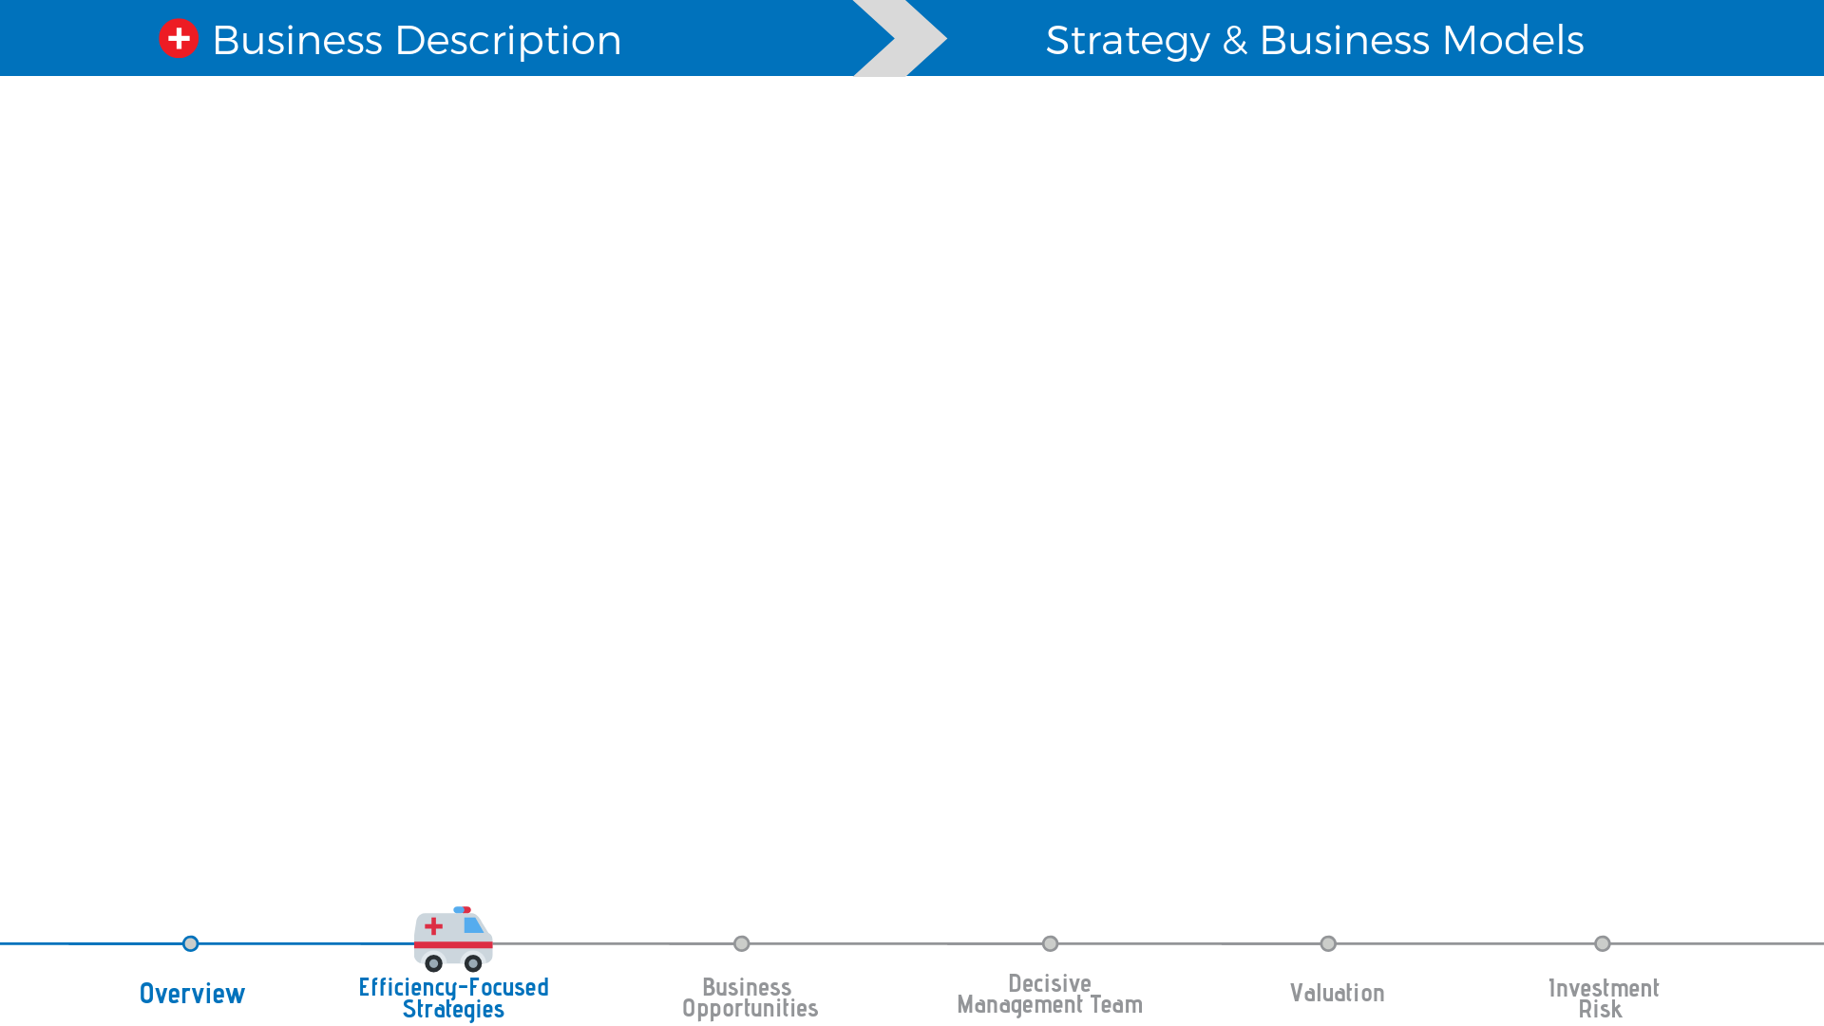
Target Price
THB 27.00
Market Price
THB 23.60 at 17th Jan 2019
Recommendation
BUY
15% of upside
75% DCF + 25% P/E multiplier
Efficiency-focused Strategies
from the Solid Business Model
Business Opportunities
For both Oversea and Domestic Demand
Decisive
Management Team
Sustaining Financial Performance
and
Implementing Effective Strategies
Notes:
แล้วต่อมาให้เอาสามเหตุผลดันภาพเดิมขึ้นไปอ่ะครับ อารมณ์ว่าเป็นสามเสาหลักในการ support ราคาเป้าหมาย
อยากได้กราฟฟิกประมาณ วิหารกรีกอ่ะครับ

Slide 4


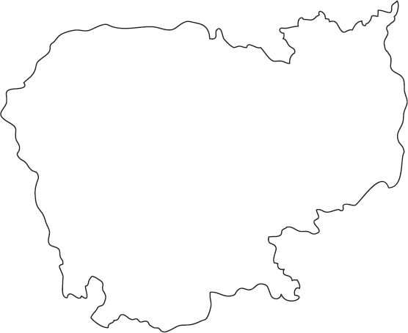
1972
2005
2007
2014
2011
2018
- The Wellness Center
- Chiva Transitional care
Bangkok Hospital was established.
s Description
- Bangkok Samui & Phuket hospitals
- Samitivej
- Wattanosoth
- BNH
- Royal Hospitals in Cambodia
- Phayathai hospitals
- Paolo hospitals
- Bangkok Hospital Chiangmai
- Bangkok Hospital Khonkaen
2018
- The Wellness Center
- Chiva Transitional
2014
- Bangkok hospital Chiangmai
- Bangkok hospital Khonkean
2005
- Bangkok Samui & Phuket hospitals
- Samitivej
- Wattanosoth
- BNH
2011
- Phayathai hospital
- Paolo hospital
No.Hospitals
2007
- Royal hospital in Cambodia
37
12
46
28
18
1

Slide 5
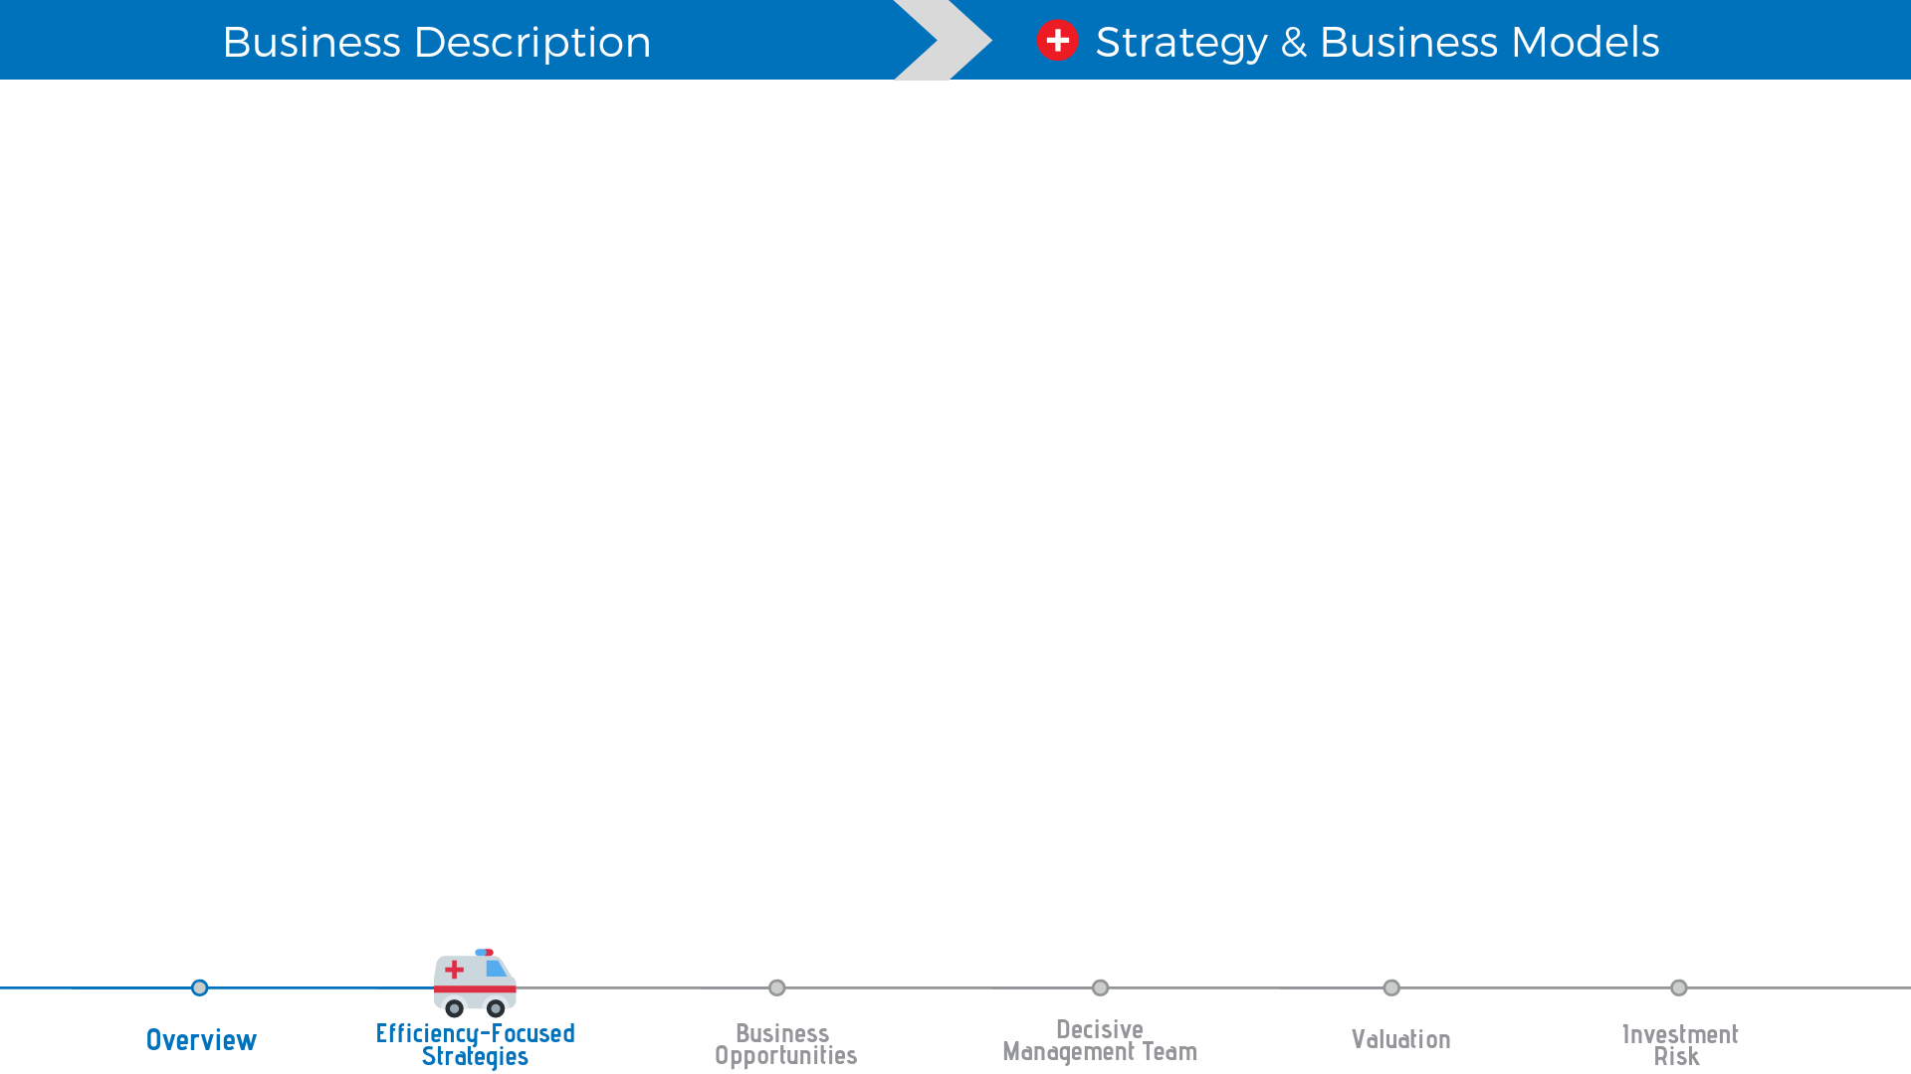
Efficiency-focused strategy
Centers of Excellence (CoE)
Hub and spoke model
Continuum of Healthcare
Non-hospital businesses

Slide 6
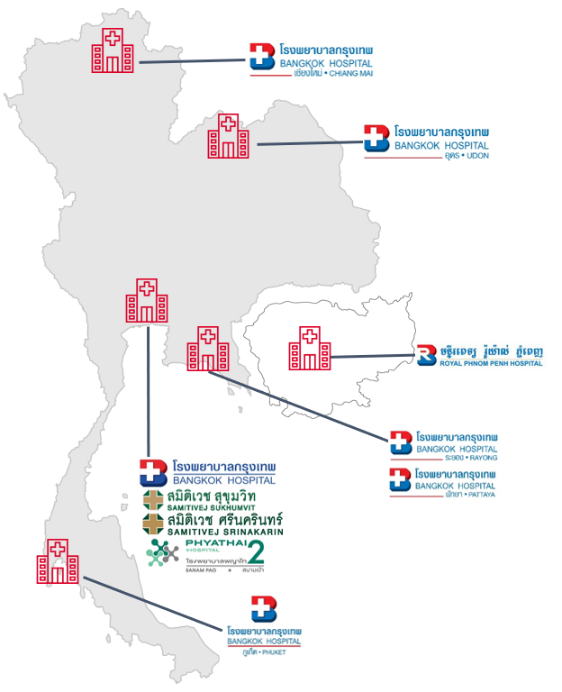
Efficiency-focused strategy
Centers of Excellence (CoE) Tertiary and super tertiary
Hub and spoke model
Continuum of Healthcare
Non-hospital businesses

Slide 7
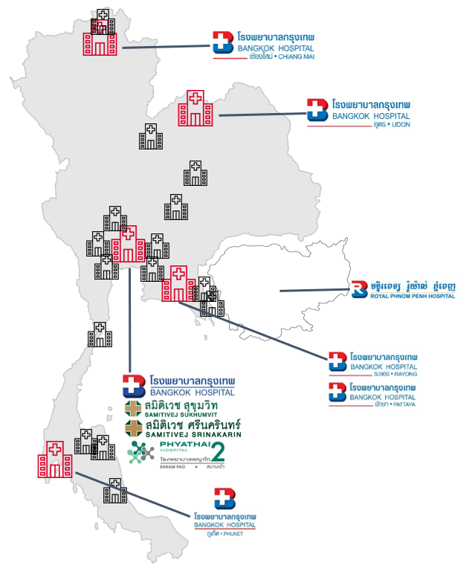
Efficiency-focused strategy
Centers of Excellence (CoE) Tertiary and super tertiary
Hub and spoke model Resource sharing
Continuum of Healthcare
Non-hospital businesses

Slide 8

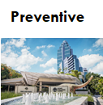
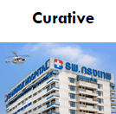
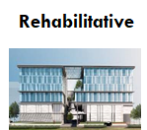
Efficiency-focused strategy
Centers of Excellence (CoE) Tertiary and super tertiary
Hub and spoke model Resource sharing
Continuum of Healthcare Diversified customer base
Non-hospital businesses
Notes:
โลโก้จาก ไฟล์ appendix หน้า7 (ที่เป็นรูปแผนที่)

Slide 9

Efficiency-focused strategy
Centers of Excellence (CoE) Tertiary and super tertiary
Hub and spoke model Resource sharing
Continuum of Healthcare Diversified customer base
Non-hospital businesses Strong supply chain

Slide 10
Efficiency-focused strategy
Centers of Excellence (CoE) Tertiary and super tertiary
Hub and spoke model Resource sharing
Continuum of Healthcare Diversified customer base
Non-hospital businesses Strong supply chain

Slide 11
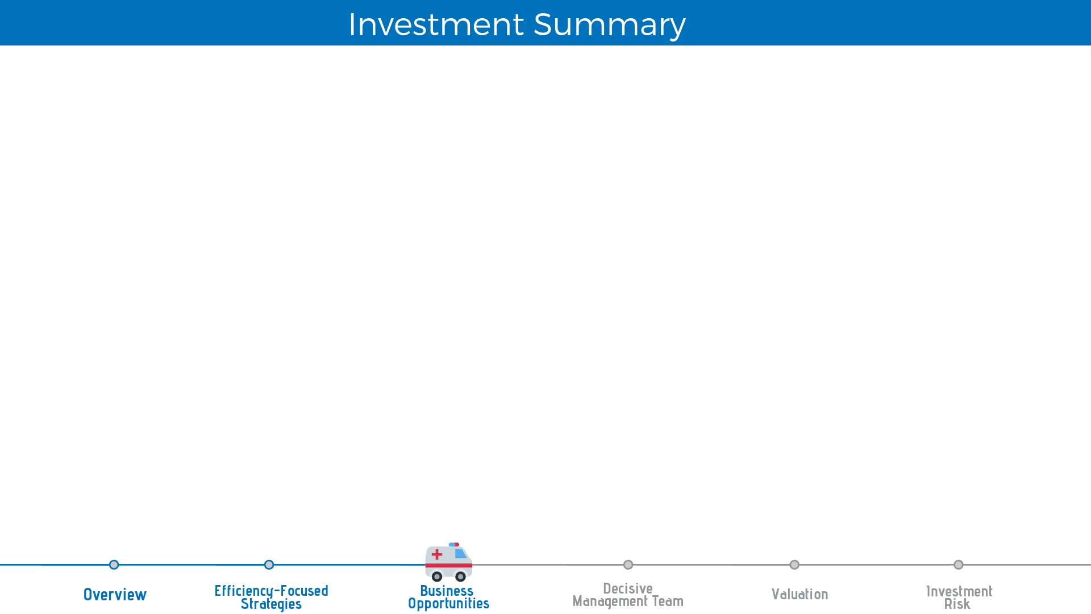
Target Price
THB 27.00
Market Price
THB 23.60
Recommendation
BUY
15% of upside
75% DCF + 25% P/E multiplier
Efficiency-focused Strategies
from the Solid Business Model
Business Opportunities
For both Oversea and Domestic Demand
Decisive
Management Team
Sustaining Financial Performance
and
Implementing Effective Strategies
Notes:
แล้วต่อมาให้เอาสามเหตุผลดันภาพเดิมขึ้นไปอ่ะครับ อารมณ์ว่าเป็นสามเสาหลักในการ support ราคาเป้าหมาย
อยากได้กราฟฟิกประมาณ วิหารกรีกอ่ะครับ

Slide 12
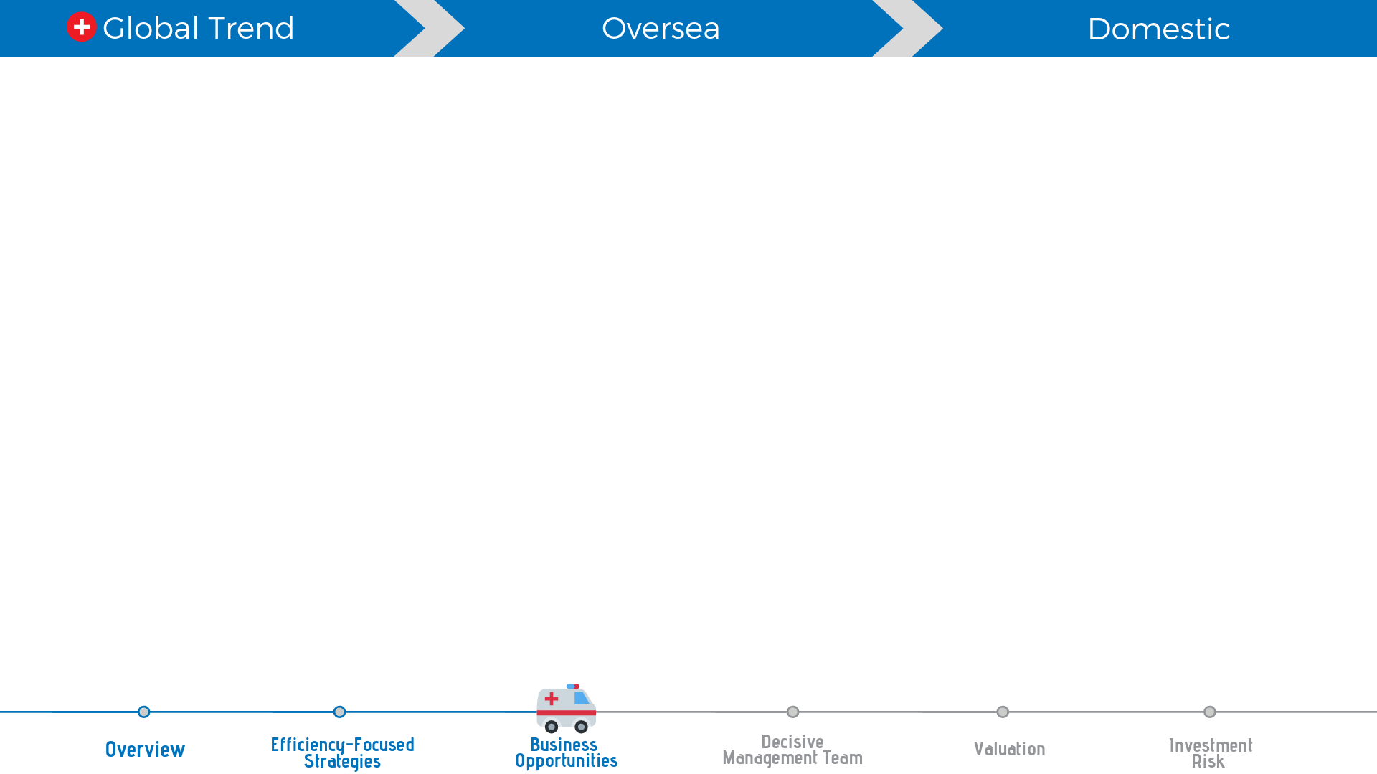
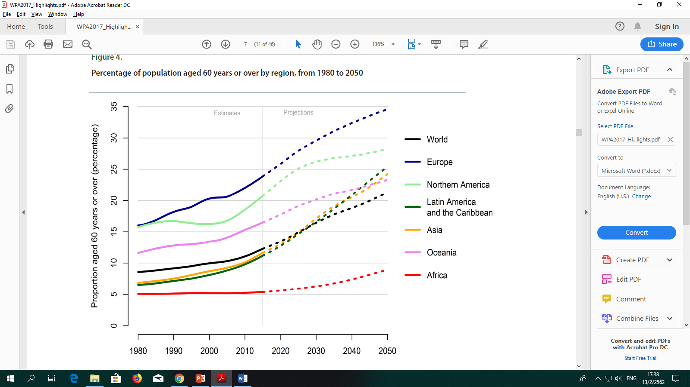
Global Mega Trend
Higher expectation of Aging population around the world.
Source: United Nations (2017). World Population Prospects: the 2017 Revision.
Notes:
Script1:
1.1 mega trend ที่ทั่วโลกกำลังเผชิญและจะทวีความรุณแรงขึ้นในอีกไม่กี่ปีข้างหน้าได้แก่ aging society ที่จำนวนผู้สูงอายุจะเพิ่มสูงขึ้นและประเทศไทยเป็นหนึ่งในนั้น อีกทั้งโรคที่ผู้สูงอายุจะต้องเผชิญส่วนใหญ่จะเป็นโรคที่ยากต่อการรักษา

Slide 13
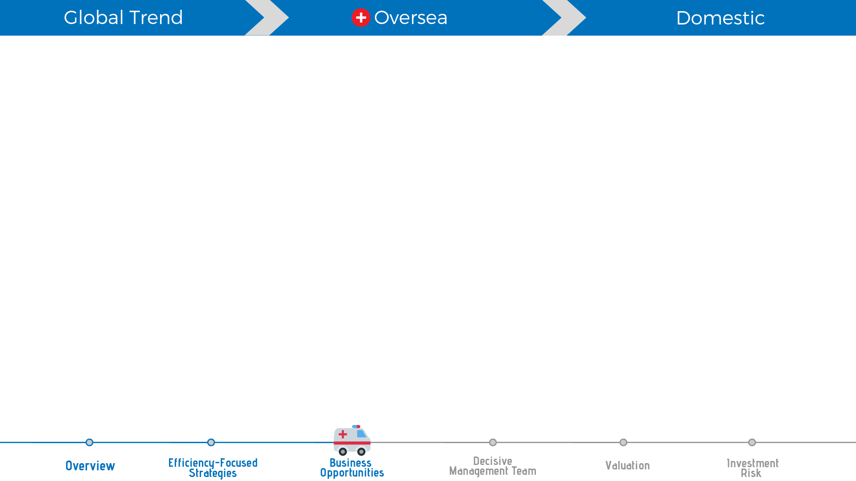




Competitive Price
Quality
Medical Hub
Price
Tourist Destination
Tourist Destination
Quality
Notes:
Script2:
2.1 จากต่างประเทศ เรามีข้อได้เปรียบคือ คุณภาพ ราคาที่สามารถแข่งขันได้(ถูกกว่า) และความเป็น top tourist destination นอกจากนั้นยังมีนโยบาย medical hub ที่รัฐบาลพยายามส่งเสริม ทำให้สามารถดึงดูดชาวต่างชาติให้เข้ามาผ่านทั้งทางตรงและmedical tourism
guide: จาก Quality + price + tourist destiantion ทำให้เกิดการเข้ามาท่องเที่ยวผ่าน medical tourism คู่กับนโยบาย medical hub
graph in file excel name:...

Slide 14
Oversea Capturing
With global mega trend and competitive advantages, BDMS can increase proportion of revenue from international patients.

Slide 15

Urbanization
Thailand Monthly Income per Household
CAGR 5.24%
Notes:
Script3:
3.1 ส่วนความต้องการภายในประเทศมาจากแนวโน้มของ urbanization, การเพิ่มขึ้นของชนชั้นกลาง, more household income
graph in file excel name: Urbanization, GDP per *ข้อมูลและกราฟอยู่ในแทบสีเขียวอ่อนในไฟล์ excel ครับ

Slide 16
Domestic
CAGR 8.69%
The upside trend of direct premium.
Notes:
Script3:
3.3 และประกันสุขภาพที่ทำให้โรงพยาบาลเอกชนสามารถได้รับกลุ่มลูกค้าหลากหลายมากขึ้น ดังนั้นจึงมีแรงจูงใจให้ผู้ป่วยเปลี่ยนการใช้บริการจากโรงพยาบาลของรัฐเป็นโรงพยาบาลเอกชนมากขึ้น
graph in file excel name: Direct premium
*ข้อมูลและกราฟอยู่ในแทบสีเขียวอ่อนในไฟล์ excel ครับ

Slide 17
Domestic Capturing
Higher proportion of insurance income from 2013 to 2017.
26% proportion of insurance income in 2017.

Slide 18
Domestic Capturing
Hospital networks coverage all potential locations in Thailand.
Higher proportion of up-country income

Slide 19
Business Opportunities
Global Trend
CoEs + Continuum of Healthcare
Oversea
Benefits
Strong Hospital Networks
Domestic

Slide 20
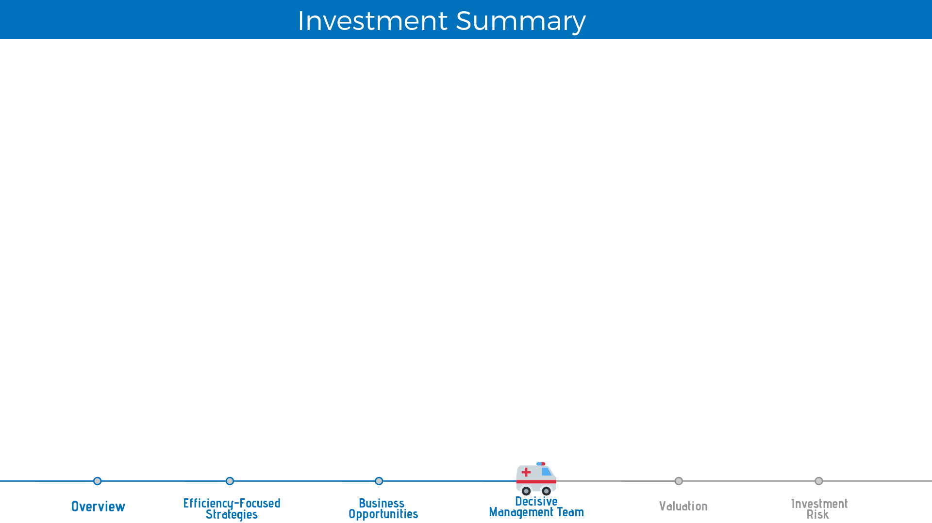
Target Price
THB 27.00
Market Price
THB 23.60
Recommendation
BUY
15% of upside
75% DCF + 25% P/E multiplier
Efficiency-focused Strategies
from the Solid Business Model
Business Opportunities
For both Oversea and Domestic Demand
Decisive
Management Team
Sustaining Financial Performance
and
Implementing Effective Strategies
Notes:
แล้วต่อมาให้เอาสามเหตุผลดันภาพเดิมขึ้นไปอ่ะครับ อารมณ์ว่าเป็นสามเสาหลักในการ support ราคาเป้าหมาย
อยากได้กราฟฟิกประมาณ วิหารกรีกอ่ะครับ

Slide 21
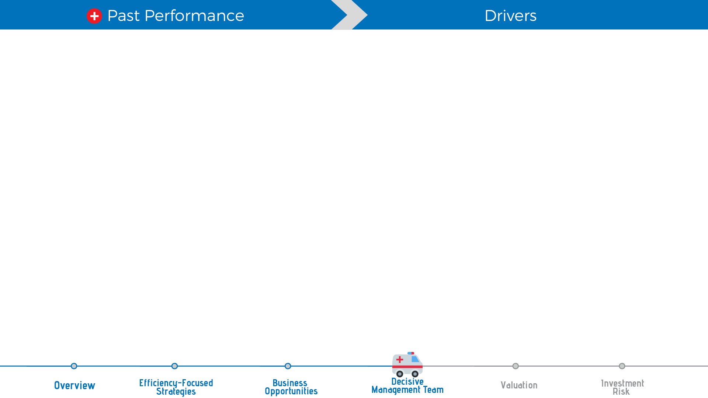
Revenue growth In expansion strategy period by acquisions and greenfields
Number of bed
Total Revenue
CAGR 8.85%
CAGR 9.18%
Notes:
Graph in Excel File:Management Team (Sheet slide2)
Script : In the past, total revenue has growth at CAGR 9.18% from the expansion strategy by acquisition and greenfield

Slide 22
Cost proportion In expansion strategy period
SG&A/Total Revenue
COGS/Total Revenue
67%
21%
65%
20%
Notes:
Excel File:Management Team (Sheet slide3)
Script : On the other hand, COGS and SG&A of BDMS are quite stable within this range 65-67% and 20-21% respectively.

Slide 23
After implementing the expansion strategy, BDMS obtained
Strategy Implementation
All strategic locations
1
Strong hospital network
2
Solid economy of scale
3
Notes:
ขอ Icon ประกอบ
Script : Now, after implementing the expansion strategy, BDMS obtained all strategic locations, strong hospital network and the solid economy of scale. BDMS is now focusing on efficiency optimization.

Slide 24
Decisive Management Team
Efficiency optimization
Revenue Drivers
Financial Performance
Management Team
Strategy Implementation
Cost Drivers

Slide 25
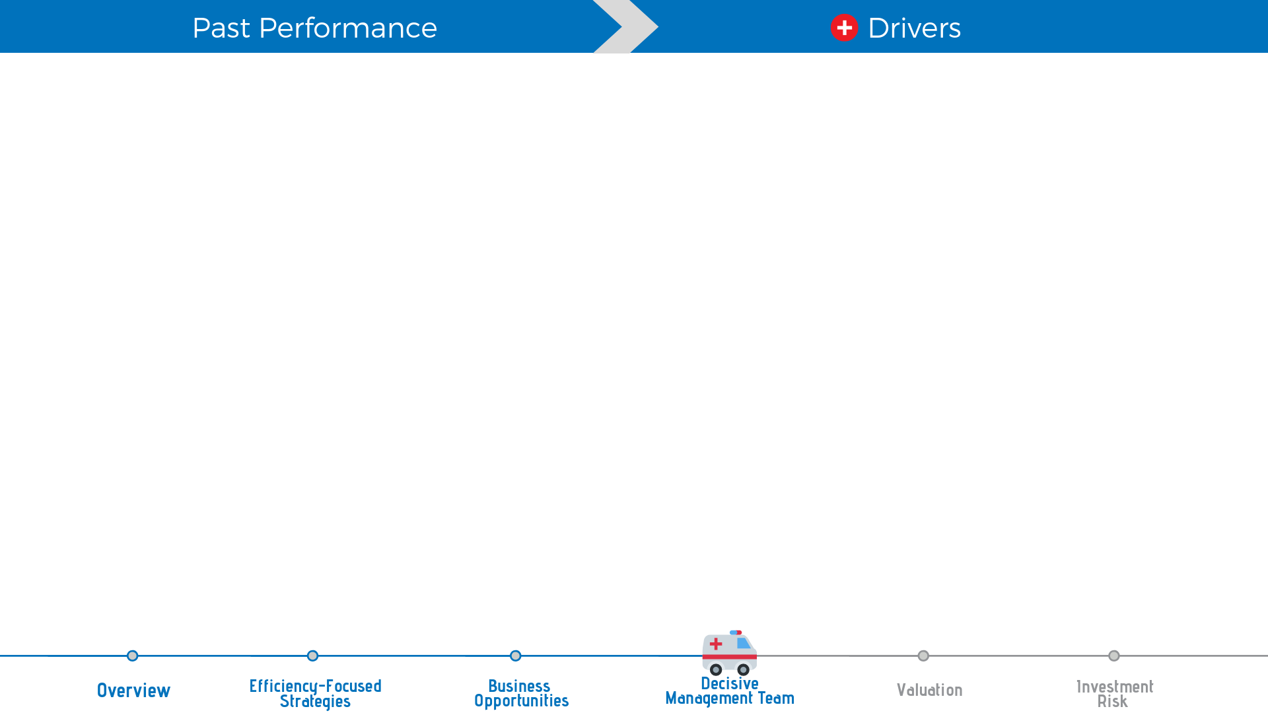

Revenue Driver
Total Revenue Forecast
Preventive
Curative
Rehabilitative
Notes:
Excel File:Management Team (Sheet slide5)
Script : There are 2 revenue drivers 1. centers of excellence generate higher income and also margin for the firm. 2. continuum of healthcare expands BDMS’s customer base by offering preventive and rehabilitative care.
BDMS is ready for upcoming opportunities from both domestic and overseas.

Slide 26
Revenue Driver
Total Revenue Forecast
Centers of Excellence
Preventive
Curative
Rehabilitative
Notes:
Excel File:Management Team (Sheet slide5)
Script : There are 2 revenue drivers 1. centers of excellence generate higher income and also margin for the firm. 2. continuum of healthcare expands BDMS’s customer base by offering preventive and rehabilitative care.
BDMS is ready for upcoming opportunities from both domestic and overseas.

Slide 27



Revenue Driver
Total Revenue Forecast
Centers of Excellence
Preventive
Curative
Rehabilitative
Notes:
Excel File:Management Team (Sheet slide5)
Script : There are 2 revenue drivers 1. centers of excellence generate higher income and also margin for the firm. 2. continuum of healthcare expands BDMS’s customer base by offering preventive and rehabilitative care.
BDMS is ready for upcoming opportunities from both domestic and overseas.

Slide 28

Cost Driver
Strong Network + Hub & Spoke
Resource Sharing
Economy of scale + Centralized Procurement
Power of Bargaining
Cost Reduction
Non-Hospital Businesses
Supply Chain Control
Notes:
Script : In a part of Cost Driver,BDMS have strong hospital network by Hub & Spoke model that enhances resource sharing among their network.While,Their economy of scale supports centralized procurement with full power of bargaining. In addition,BDMS’s investment in non-hospital business supports supply chain control.Thus, 3 bullet can help cost reduction of BDMS

Slide 29
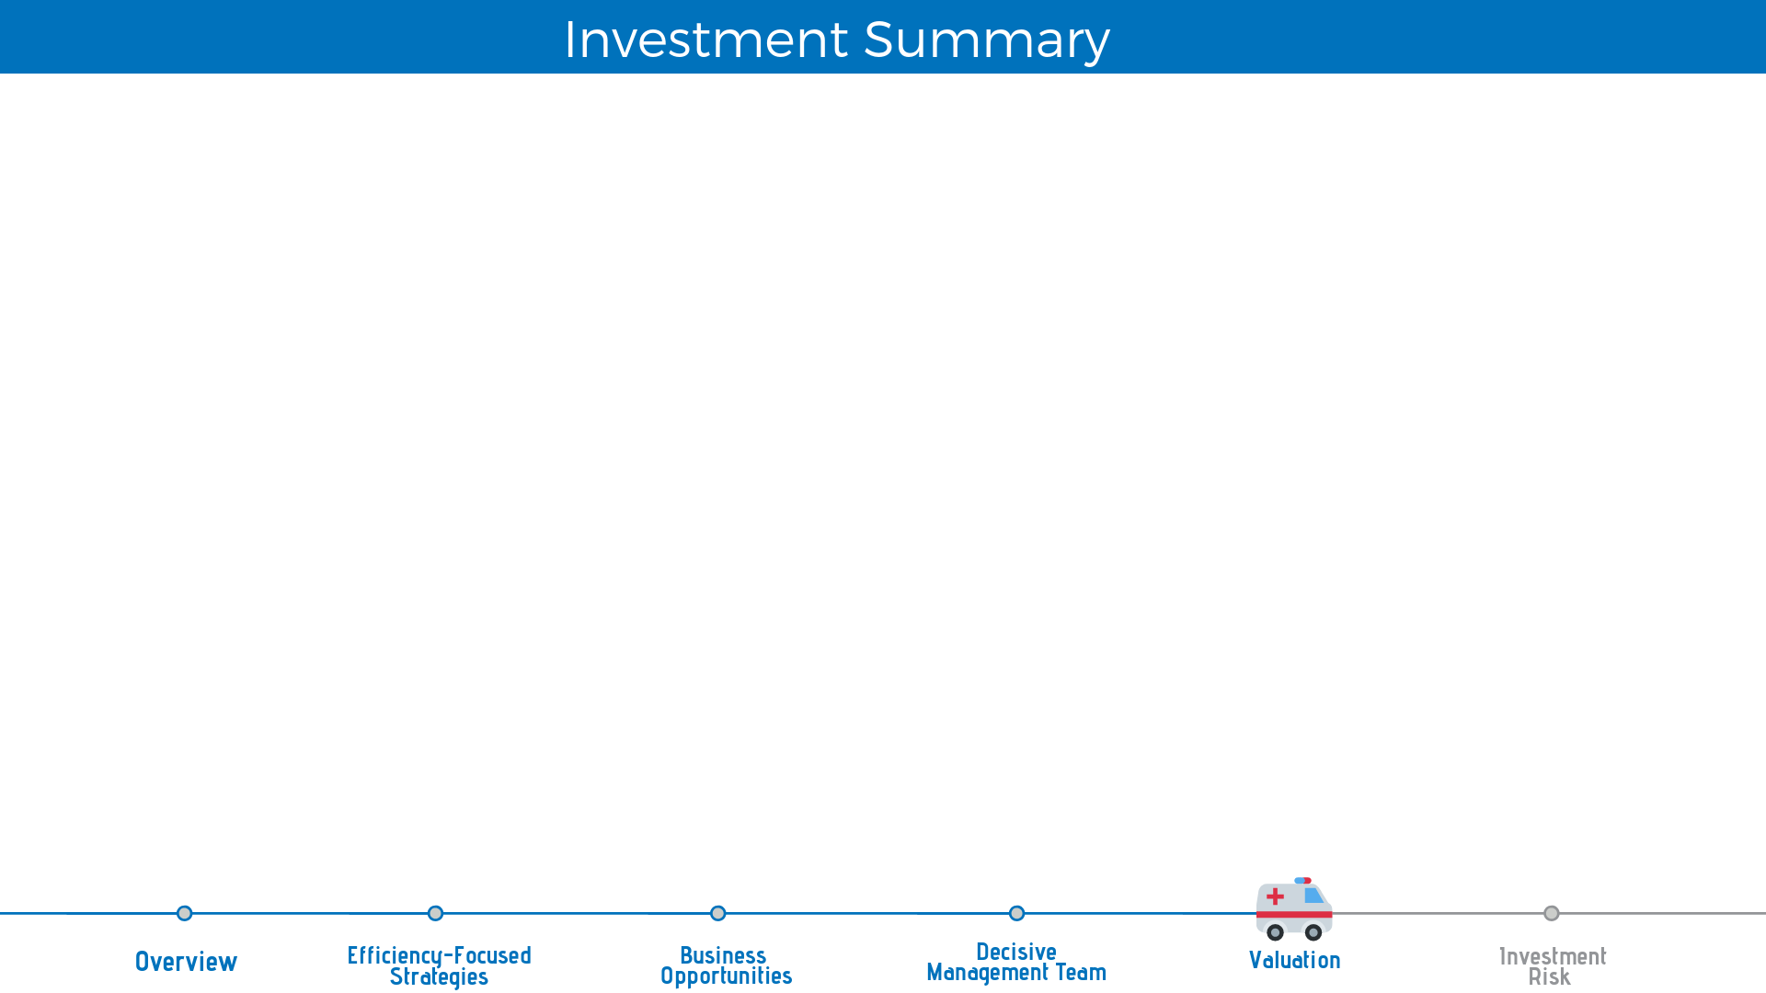
Target Price
THB 27.00
Market Price
THB 23.60
Recommendation
BUY
15% of upside
75% DCF + 25% P/E multiplier
Efficiency-focused Strategies
from the Solid Business Model
Business Opportunities
For both Oversea and Domestic Demand
Decisive
Management Team
Sustaining Financial Performance
and
Implementing Effective Strategies
Notes:
แล้วต่อมาให้เอาสามเหตุผลดันภาพเดิมขึ้นไปอ่ะครับ อารมณ์ว่าเป็นสามเสาหลักในการ support ราคาเป้าหมาย
อยากได้กราฟฟิกประมาณ วิหารกรีกอ่ะครับ

Slide 30
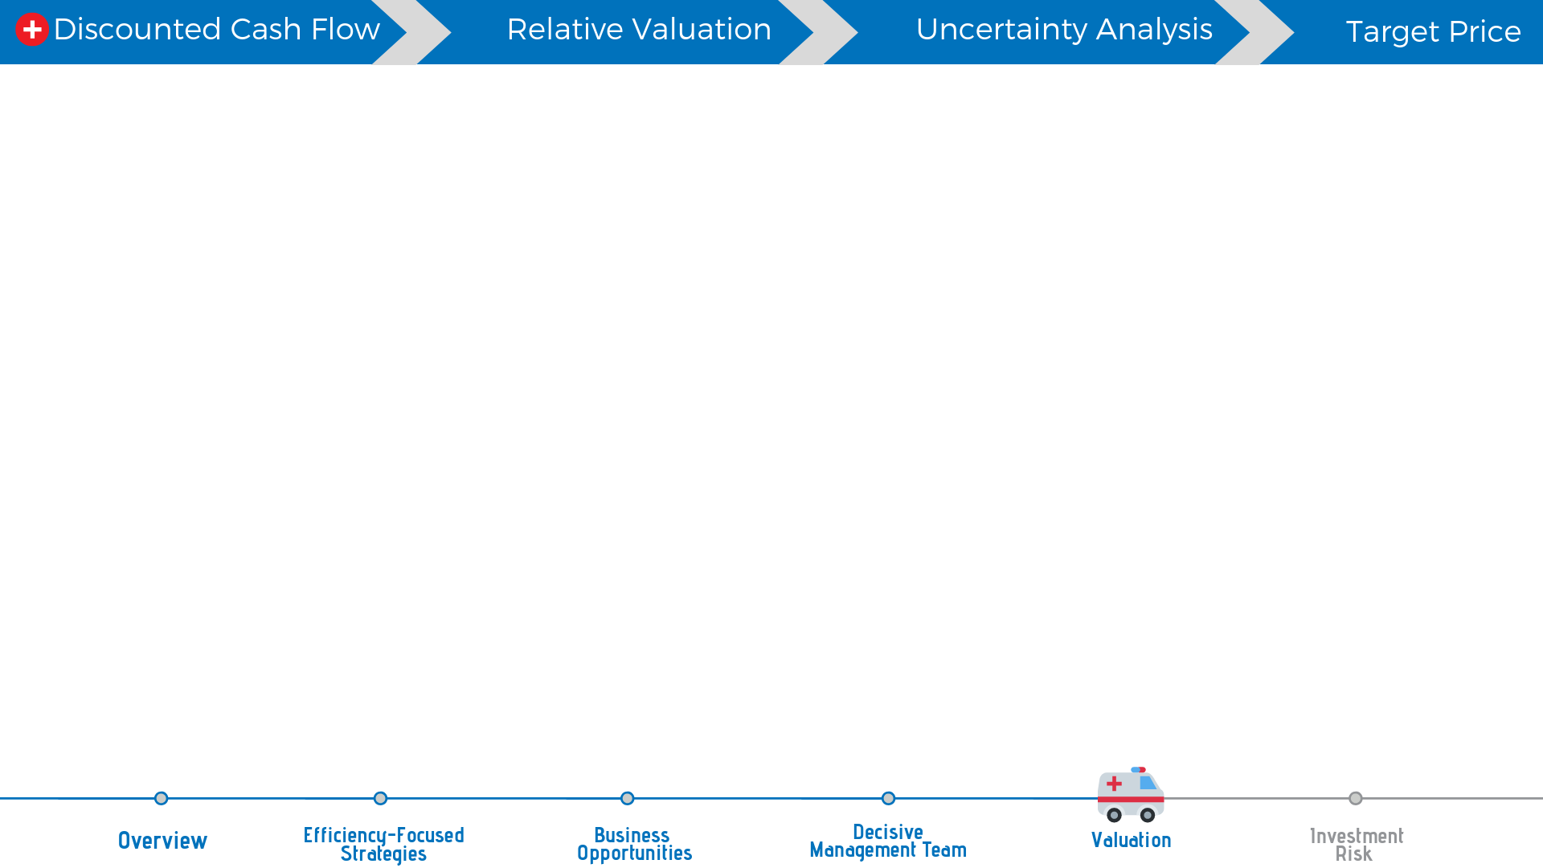
Benefit of DCF model
1. Truly capture fundamental
drivers of a business
2. Future growth
3. Change in systematic risk
BDMS’s portfolio

Slide 31
Top-line operating revenue
Hospital Business
94%
of total operating revenue
Non-hospital Business
6%
of total operating revenue

Slide 32
Hospital Business
46 Hospitals
The different
1. Age and state of hospital
2. Location
3. Services performance
4. Target customer
3 Sub-group
Revenue growth will difference in each sub-group
1. CoEs group : 10 CoEs Hospital
2. Mature-state group
3. Ramping-up group : Operate less than
5 years under BDMS’s name
Hospitals
Sub-groups

Slide 33
Hospital Business
CoEs
2019F provide 55% of hospital’s revenue.
6.5% CAGR
6.5% CAGR
Notes:
First, CoEs group. This group provide 55% of hospital revenue, with a 6.5% CARG.

Slide 34
Hospital Business
Number of Mature-state hospital in 2019F
Mature-State
6.1% CAGR
More than half of BDMS’s hospital are in this group
The lowest growth at 6.1% CAGR
Notes:
Second, The Mature-state group. Half of BDMS’s hospitals are in this group. The lowest growth of BDMS’s sub-group with a 6.1% CAGR.

Slide 35
Hospital Business
Number of Mature-state hospital in 2019F
Ramping-up
Hospitals that operate under BDMS’s name less than 5 year are in this group
Highest growth with 15.05% CAGR
Notes:
Lastly, Ramping-up group. The highest growth in BDMS sub-group, contain a 15% CAGR. Hospital that operate less than 5 years under BDMS name is in this group.

Slide 36
Total operating revenue
Total Revenue CAGR
7.26%
Hospital Revenue CAGR
7.07%
Non-hospital Revenue CAGR
10.41%
CoE group CAGR
6.5%
Mature-state group CAGR
6.1%
Ramping-up group CAGR
15.05%
CAGR 7.26%

Slide 37
Bed utilization rate
BDMS Medical Inflation
3%
price annual adjustment
Notes:
We also create another method to cross-check the DCF valuation. We take Bed utilization rate and medical inflation to our model. The result of this is similar to main method.

Slide 38
Free Cash Flow to Firm
WACC
6.27%
Terminal growth
3.00%
Fair price
27.09 baht
WACC Calculation
10Y Thailand Government Bond | 2.49%
Beta | 0.703
Expected Market Return | 10.31%
Cost of Equity | 7.99%
Cost of Debt After Tax | 2.76%
Taxes Rate | 20.00%
Financial-Debt to Assets | 27.68%
WACC | 6.27%
Terminal growth | 3.00%
Notes:
For the discounted cash flow, we use a free cash flow to firm. We made a 5-year projection. Cost of capital is 6.27%. We got 27.09-baht form DCF valuation.

Slide 39
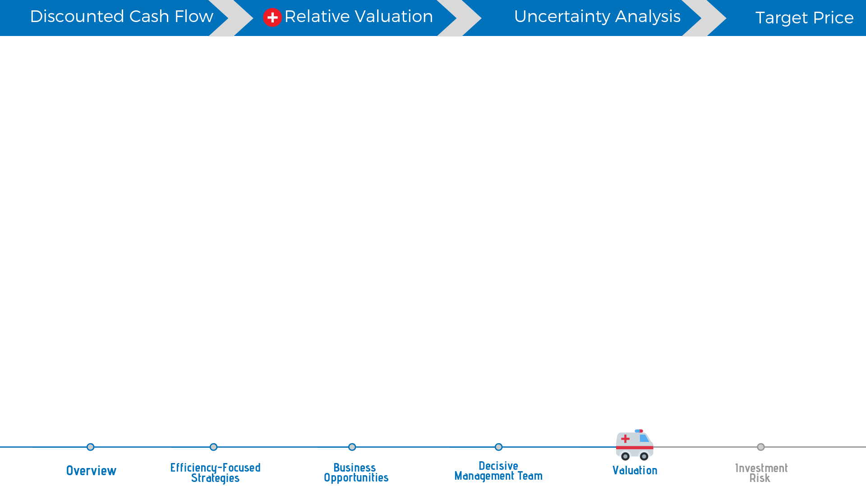







Competitors
BDMS
Premium group
BH : Bumrungrad Hospital PCL IHH : IHH Healthcare Berhad KPJ : KPJ Healthcare Berhad
Middle level
BCH : Bangkok Chain Hospital PCL RAM : Ramkhamhaeng Hospital PCL CHG : Chularat Hospital PCL IBHA : Vibhavadi Medical Center PCL Public hospital
Local Hospital
CMR : Chiang Mai Ram Medical Business PCL AHC : Aikchol Hospital PCL EKH : Ekachai Medical Care PCL RPH : Ratchaphruek Hospital PCL M-CHAI : Mahachai Hospital PCL

Slide 40
Relative valuation
Bottom-up | P/E
Hospital Group
Top - class | 29.09
Middle - class | 38.00
Local - class | 27.85
Non-Hospital Group | 37.77
Raw P/E | 32.23
Adjusted Factor | 9.80%
P/E multiplier | 35.38
Valuation
#Shares | 15,862.15
Earning 19F | 11,818.47
Price per Shares | 26.36
Bottom-up P/E
35.38x
2019F Earning
11,818.47 billion Baht
Fair price
26.36 Baht
Notes:
After discounted cash flow we move on to the relative valuation. We build bottom-up P/E which classify by peers. we got a value of 35x. The fair price of this method is 26.36 baht.

Slide 41
Target price
(Adjusted to tick sizes)
27.00Baht
Upside potential
15%
Discounted Free cash flow
Free Cash flow to Firm
Target price
27.09
75% of weight
Relative Valuation
Bottom-up P/E
Target price
26.36
25% of weight
Notes:
We allocate 75% of target price to the discounted cash flow and 25% to P/E multiplier, so the target price is 27.00 baht.

Slide 42
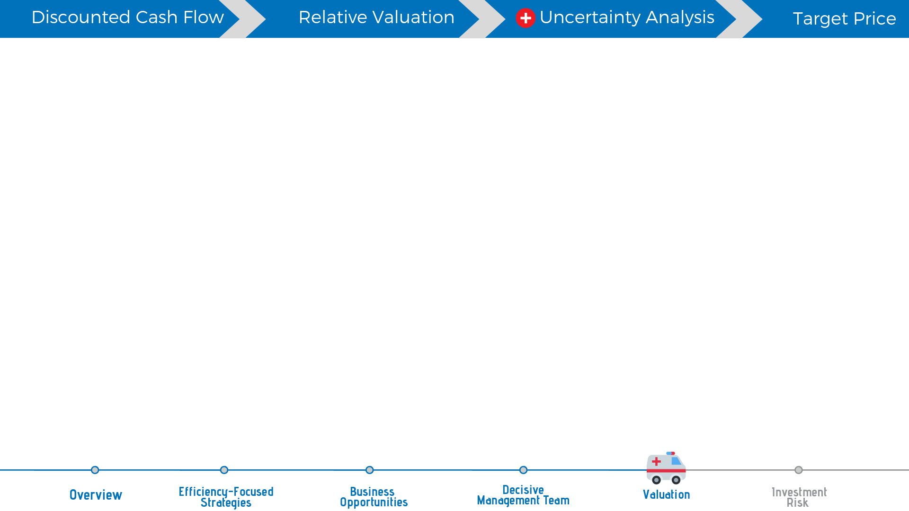
Uncertainty Analysis
Target price
27.00 Baht
Market price
23.6 Baht
On 17 January 2019
Monte-Carlo simulation
4
WACC
Terminal growth
Revenue growth (CAGR)
%COGS
60,000
Times
Factors to concern.
75%
of a
BUY
recommendation
Sell
5%
Hold 20%
Buy 75%
Notes:
For the uncertainty analysis. We performed 60,000 times for Monti-Carlo simulation for the 4 factors and we observe a 75% probability of a buy recommendation.

Slide 43

Target price
(Adjusted to tick sizes)
27.00 Baht
Upside potential
15%
Dividend yield
2.08%
Target price 27.00 Baht
Notes:
As the result of our valuation models and uncertainty analysis we are confident to give you a buy recommendation with target price of 27.00 baht. present a 15% upside potential.

Slide 44
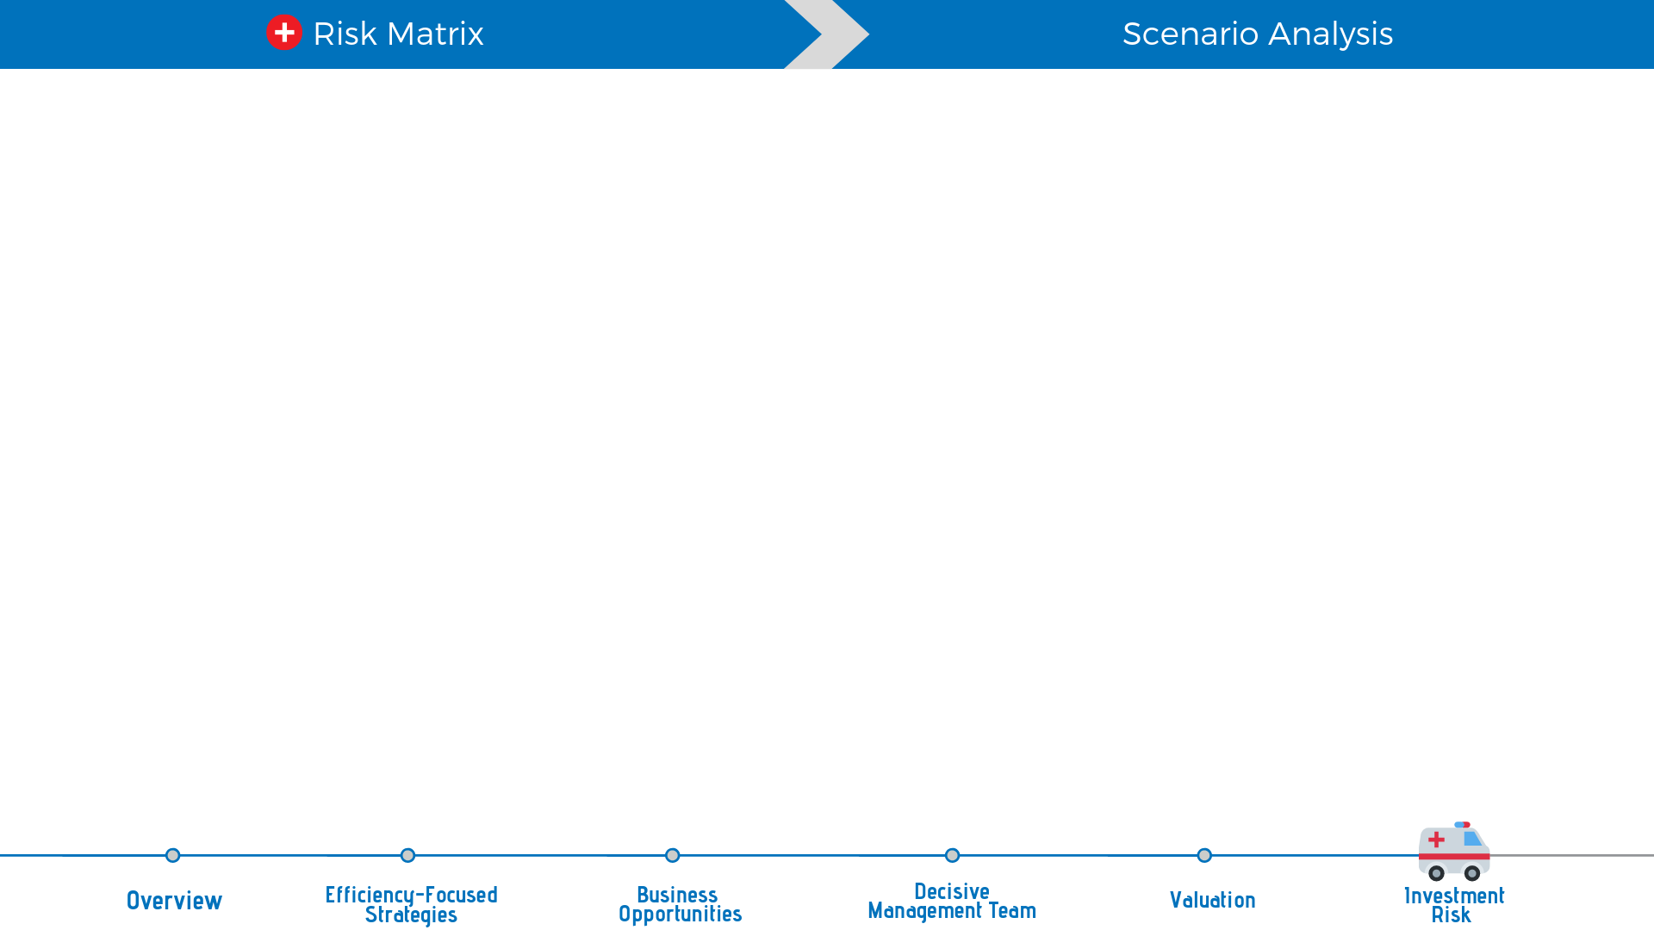
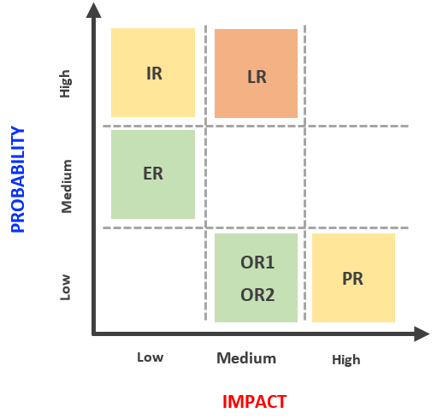
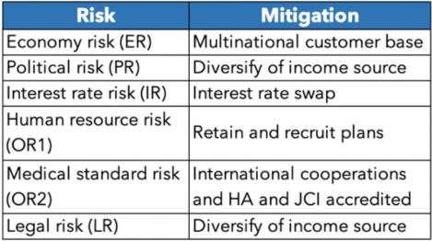
Investment Risk
Controlled Products and Services
Notes:
ตอนแรกภาพมาเต็มทั้งหมด จากนั้นเน้นที่ Legal Risk (LR) ให้สีเข้มเหมือนเดิม แต่ตัวอื่นๆ ซีดจางลงไป ทั้ง Matrix ทางซ้าย และ ตารางทางขวา

Slide 45
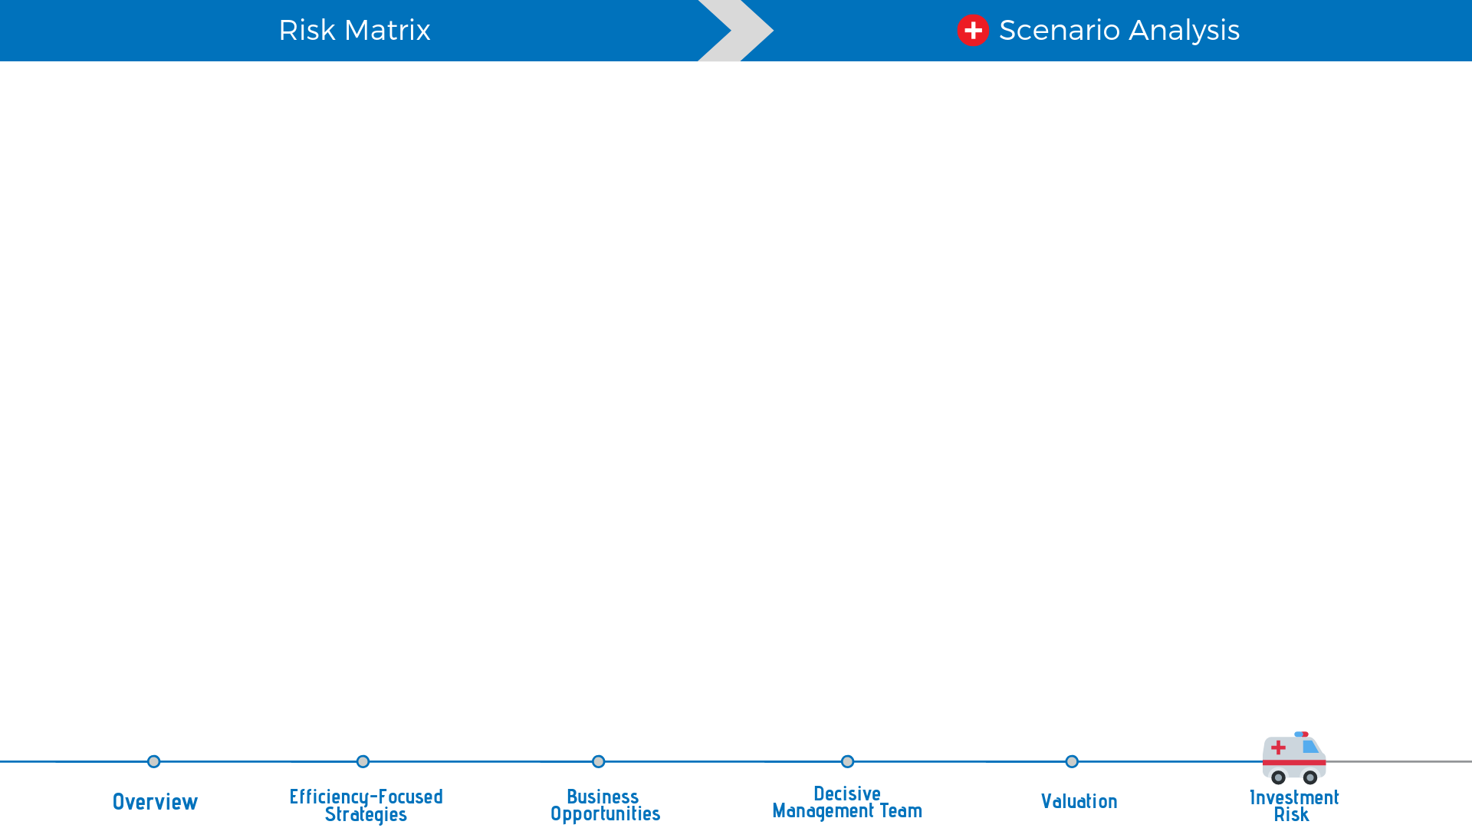
Scenario Analysis
Worst case scenario: Price controls on medicine and medical services
Revenue -10%, COGS +1% and SG&A +0.5%.
Best: THB29.53
Base: THB27.09
Worst: THB24.07
Notes:
ในตาราง เน้นที่ DCF-Worse I และ DCF - Worse II

Slide 46
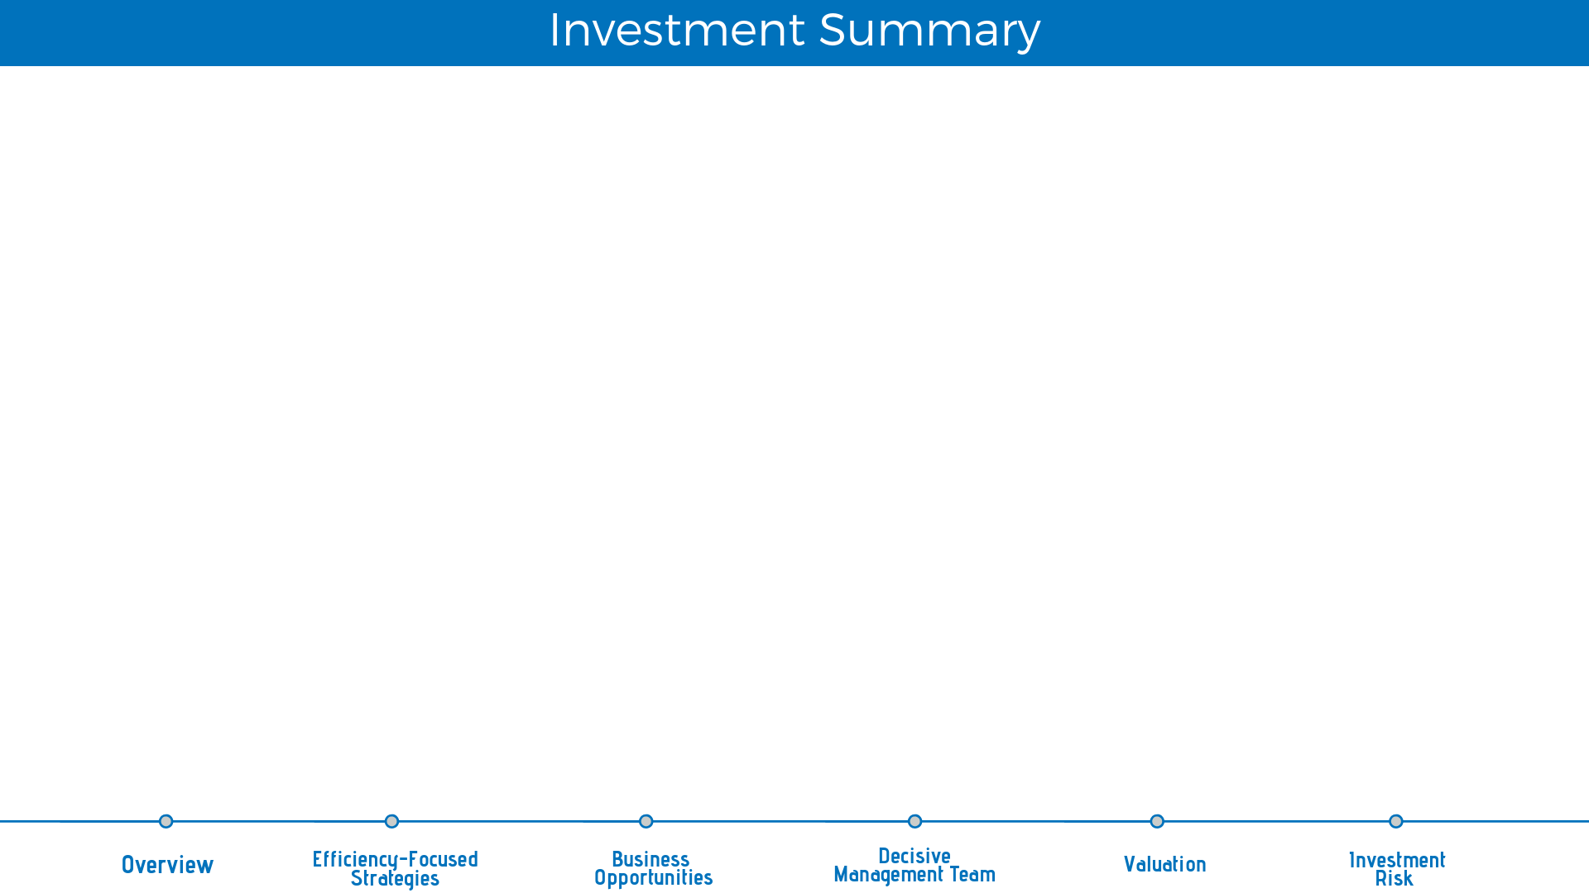
Target Price
THB 27.00
Market Price
THB 23.60 at 17th Jan 2019
Recommendation
BUY
15% of upside
75% DCF + 25% P/E multiplier
Efficiency-focused Strategies
from the Solid Business Model
Business Opportunities
For both Oversea and Domestic Demand
Decisive
Management Team
Sustaining Financial Performance
and
Implementing Effective Strategies
Notes:
แล้วต่อมาให้เอาสามเหตุผลดันภาพเดิมขึ้นไปอ่ะครับ อารมณ์ว่าเป็นสามเสาหลักในการ support ราคาเป้าหมาย
อยากได้กราฟฟิกประมาณ วิหารกรีกอ่ะครับ

Slide 47

Time to Harvest,
from BDMS
Investment Seed
Notes:
เป็นคำพาดหัวปิด อยากให้มีกราฟฟิคเคลื่อนไหวเล็กน้อยครับ

Slide 48
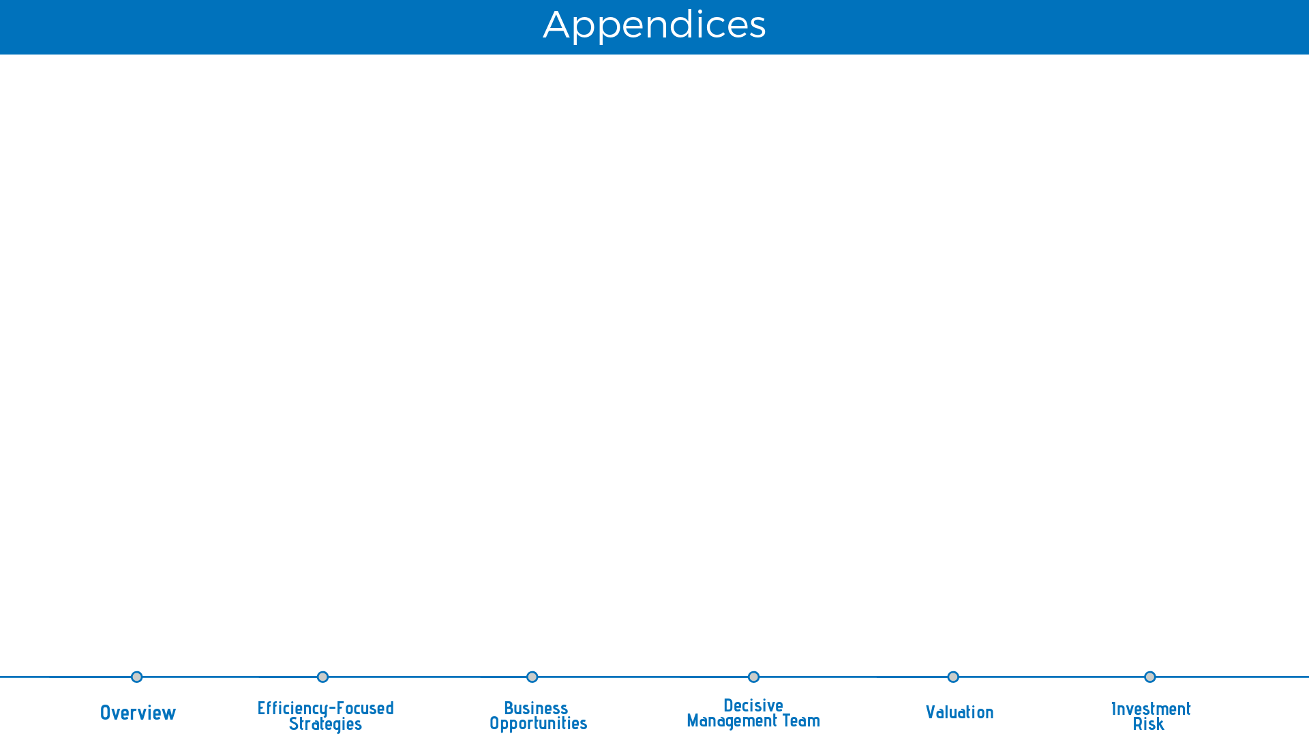
Overview
Financial Analysis
Major Shareholder & Ownership Structure-49
Revenue & Margin-75
Best Case-113
Board of Directors (2017)-50
Solvency-76
Worst Case I-114
Board of Directors (2016)-51
ROE & ROA & ROIC-77
Worst Case II-115
Income Statement-78
FCFE-116
Board of Directors (2015)-52
Balance Sheet Statement-79
DDM-117
Global Hospital Ranking-53
Financial Ratio Historical-80
P/E-118
Peers Market Cap,Revenue-81
EV/EBITDA-119
Local Hospital Ranking-54
Peers Ratio Financial Analysis-82
Sensitivities Analysis WACC & Terminal Growth-120
Hospitals Business-55
SETHEALTH MSCI-83
Tornado Chart-121
Number of Total Beds-56
Peers Margin Return Solvency-84
Monte-Carlo Analysis-122
Monte-Carlo Factors – Terminal growth-123
Revenue Contributions from Hospital Business-57
Available Bed & Occupancy rate, Patient proportion-85
Monte-Carlo Factors – Cost of Capital-124
Revenue Contribution from Non-hospital Businesses-58
Monte-Carlo Factors –Revenue Growth-125
Investment-59
Share Price and Events-86
Monte-Carlo Factors –COGs-126
Industry
JCI Accreditations of BDMS-87
SWOT Analysis-60
Valuation
Others
Five force analysis-61
Financial Highlight-88
Legal risk-96
Domestic Competitive Positioning-62
Revenue-90
Why efficiency-97
International Competitive Positioning-63
Income Statement Base case-95
Allocation-
Tourism Destination-64
Income Statement Robustness-96
Methods-
Price Comparison-65
Number of Beds-98
Cash and Liquidity-
Overview of FDI-66
Assumption-100
Medical Inflation-67
Debt-102
Continuum-
Urbanization-68
Factors for Valuation-104
Foreign proportion
GDP vs GDP Growth-69
Bottom Up Beta-105
Patient Volume
GDP Per Capita Growth (% of annual)-70
Main Method-107
Capital Management
Healthcare Expense to GDP-71
Static Model-108
Thailand's Population Age 65+ and Median Age-72
Dynamic Model-109
JCI Accredited Hospitals countries-73
Alternative Method-110
Price Comparison2-74
Revenue Per Bed Per Year-111

